Slide 1

Checking Security Properties of Cloud Service REST APIs
Presented by -
H.Komali(217r1a6624)
P.Saikiran(217r1a6642)
Ch.Gnaneswar(217r1a6612)
Under the guidance of Dr.G.Vinodha reddy (Professor)

Slide 2
01
04
Abstract
Proposed System
02
05
Existing System
Hardware Requirements
Disadvantages
03
06
Software Requirements

Slide 3
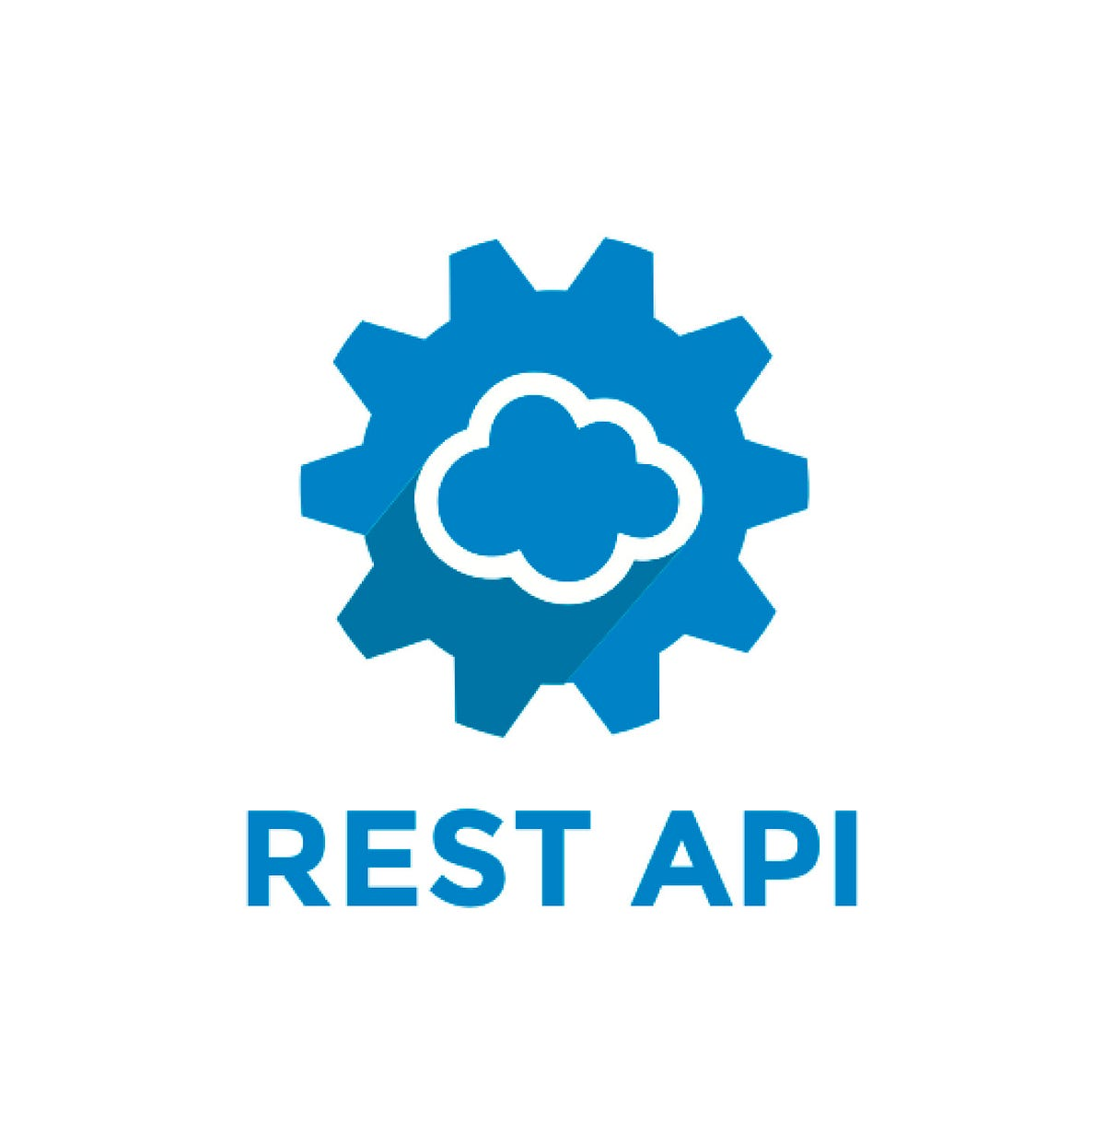
Abstract
Introduction to the rules that describe security properties of REST APIs
Design and implementation of active checkers to test and detect violations of these rules.
Presentation of experimental results evaluating the performance and effectiveness.
Discovery of new bugs in several deployed production Azure and Office 365 cloud services using the checkers

Slide 4
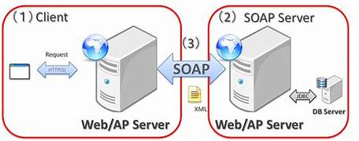
Existing Systems
SOAP web service scanner:
Simple object Access protocol. It is a messaging protocol for exchanging structured information that is data.
Limited REST API’S Testing:
A scenario where API is restricted in terms of functionalities or accessibilities example:Purposeful desing

Slide 5
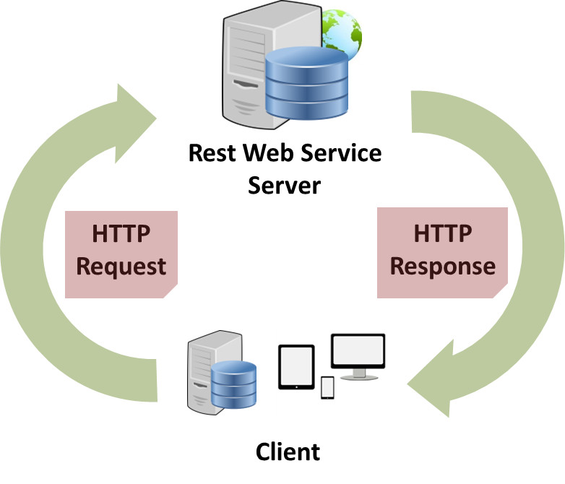
Disadvantages
Incompatibility: SOAP web service scanners, designed for a different protocol (SOAP), weren't effective for the complexities of REST APIs..
Limited Scope: Existing tools primarily focused on basic functional testing and lacked the ability to comprehensively assess security aspects.
Versioning and Compatibility:
managing multiple versions of APIs and ensuring that clients migrate to newer, more secure versions can be challenging.

Slide 6

PROPOSED SYSTEM
Stateful fuzzing:
Stateful fuzzing is a specialized technique used in software testing to identify
Vulnerabilities to stateful system.
Security Checkers for REST APIs :
Security Rules We introduce four security rules ::-
-->Use-after free rule
-->Resourse-leak rule -->Resource-heirarchy rule -->User-namespace rule

Slide 7
Advantages
Automation:
Improved Vulnerability Detection:
Real-world Validation :
It goes beyond basic errors and explores complex interactions between API calls, potentially uncovering hidden vulnerabilities.
The system automates the testing process, reducing manual effort and improving efficiency.
This approach has been successful in identifying vulnerabilities in deployed cloud services, demonstrating its effectiveness..

Slide 8
SOFTWARE REQUIREMENTS
REST API Client Library :This library allows the software to interact with various cloud provider APIs and execute various calls (GET, POST, PUT, DELETE) as needed for security checks.
Security Rule Engine: This component defines the specific security properties you want to assess and implements the logic to analyze cloud responses and configurations against those rules.
Reporting and Alerting: The software should be able to generate reports detailing the security checks performed, highlighting any discovered vulnerabilities or misconfigurations.
Fuzzing Engine: For more comprehensive testing, the software could integrate a fuzzing engine that automatically generates various invalid or unexpected inputs to the APIs, aiming to uncover potential weaknesses and edge-case vulnerabilities.

Slide 9

HARDWARE REQUIREMENTS
Processor: A modern multi-core processor is sufficient for most scenarios. I7-processor is used
RAM: 4GB of RAM is a minimum, but 8GB or more is recommended for smoother performance, especially if handling complex API interactions or large amounts of data.
Storage: 50GB of disk space should suffice for the software itself and basic operations. However, additional storage might be needed depending on the project's specific needs, such as storing logs, reports, or captured API responses for further analysis.
Operating System: Choose a stable and secure operating system compatible with your chosen software and tools. Common options include Windows 11 ,macOS, Linux

Slide 10
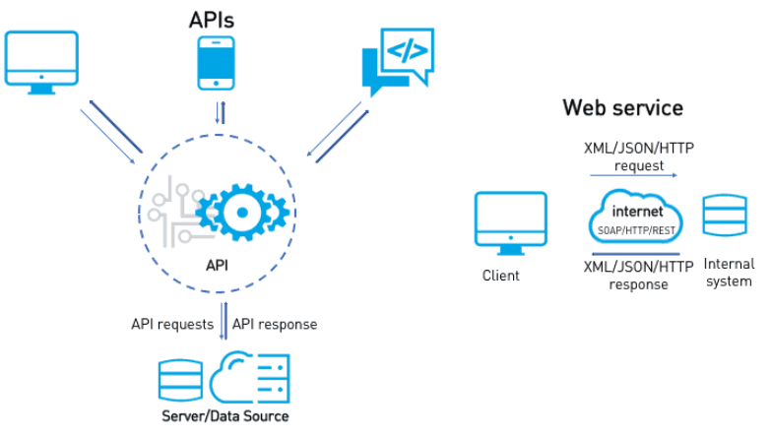
System architecture

Slide 11
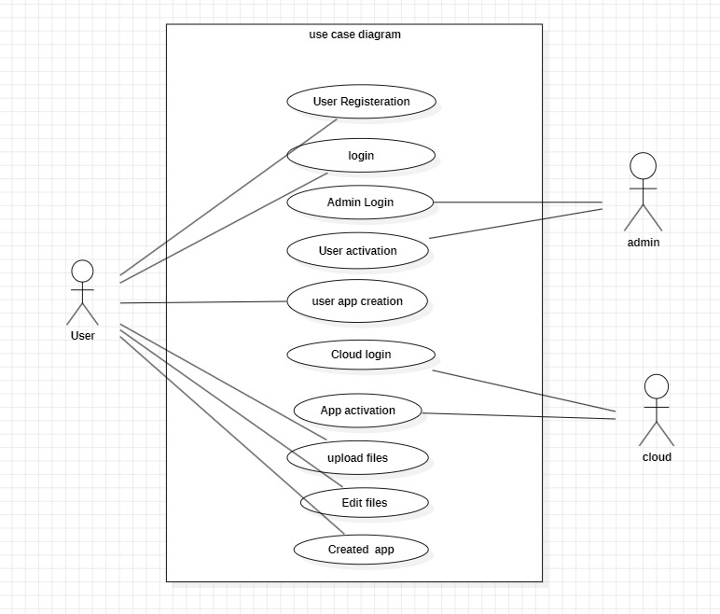
Use case diagram

Slide 12
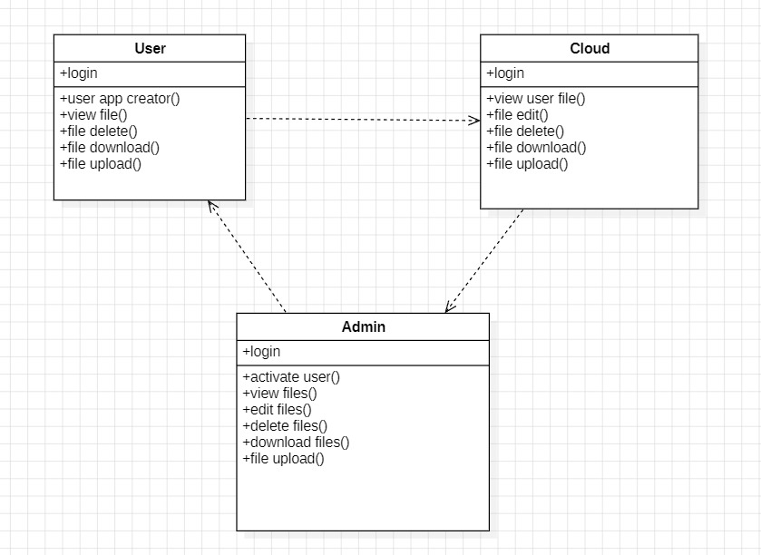
Class diagram

Slide 13
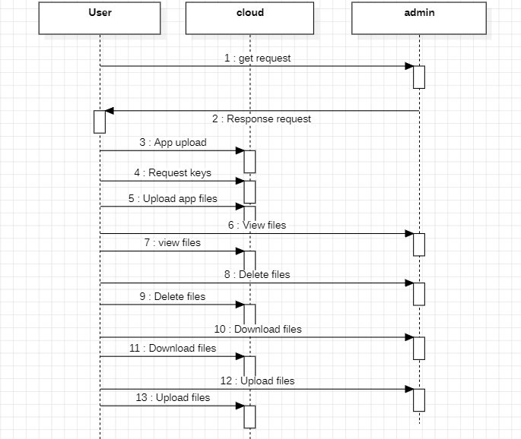
Sequence diagram

Slide 14
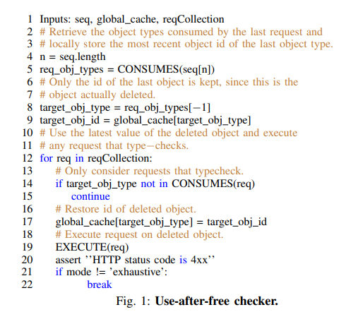
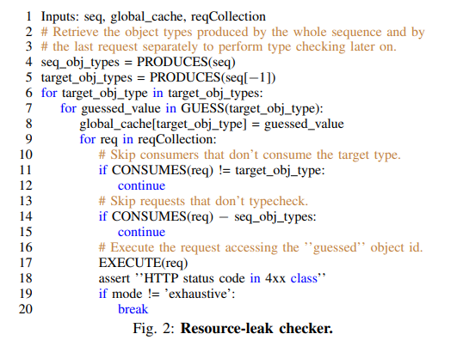
Algorithms

Slide 15
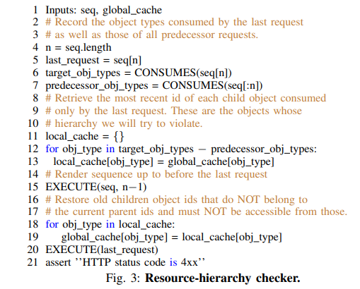
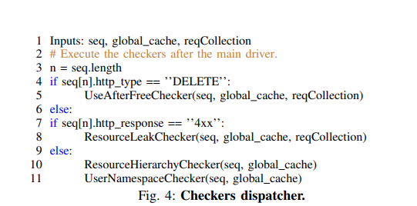
Algorithms

Slide 16
Datasets
API’s created
Azure A
Azure B
O-365 C

Slide 17
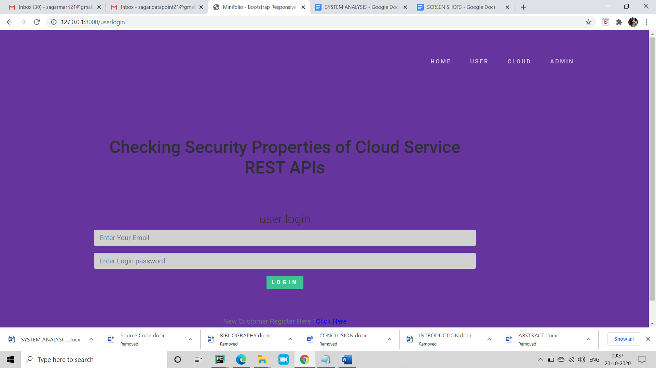
Results and Project excuetion

Slide 18
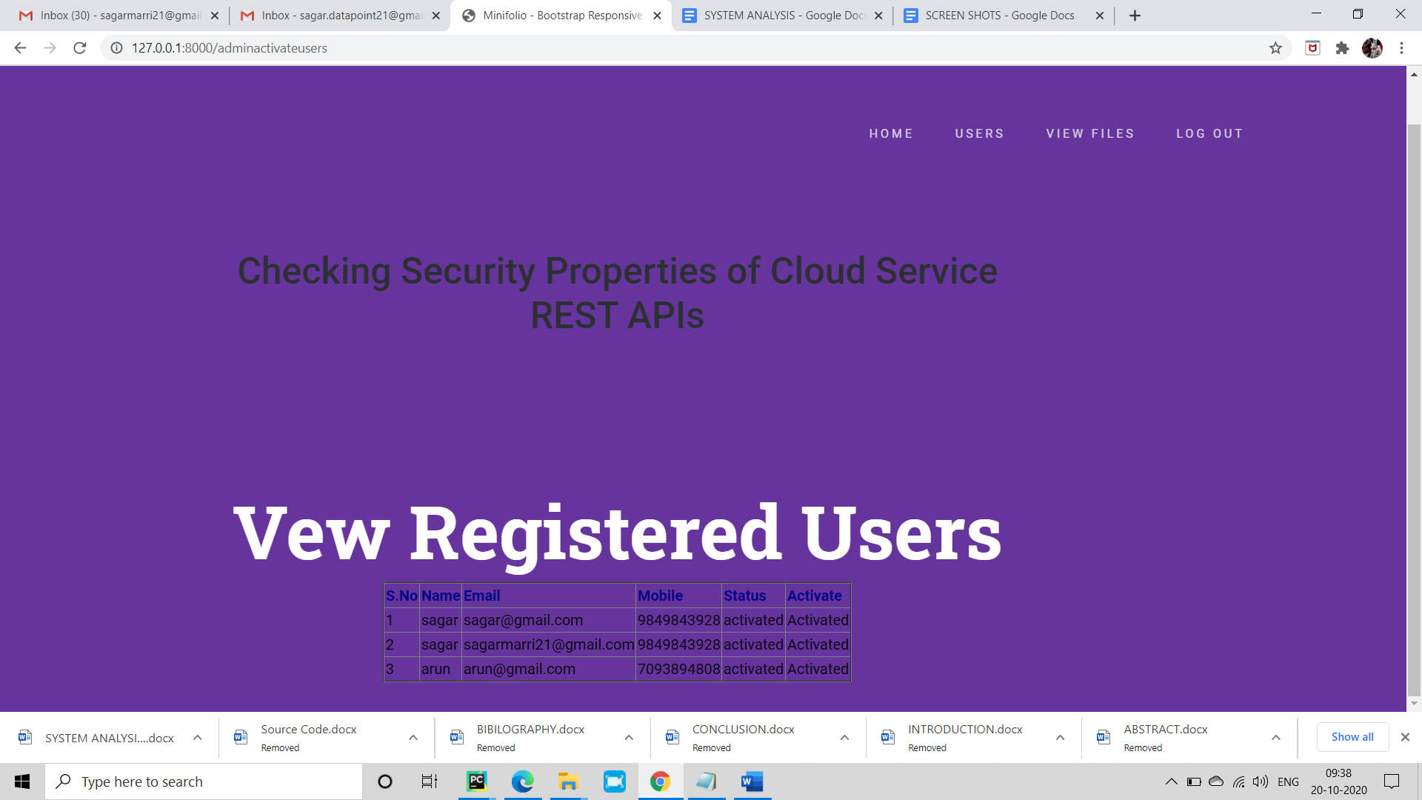

Slide 19
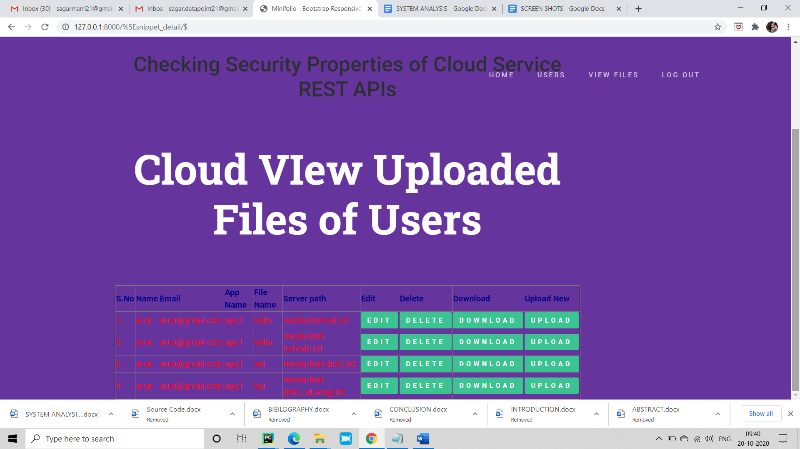

Slide 20
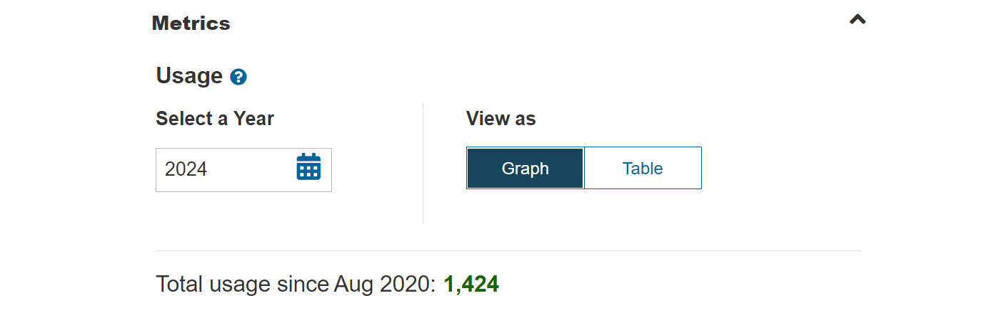
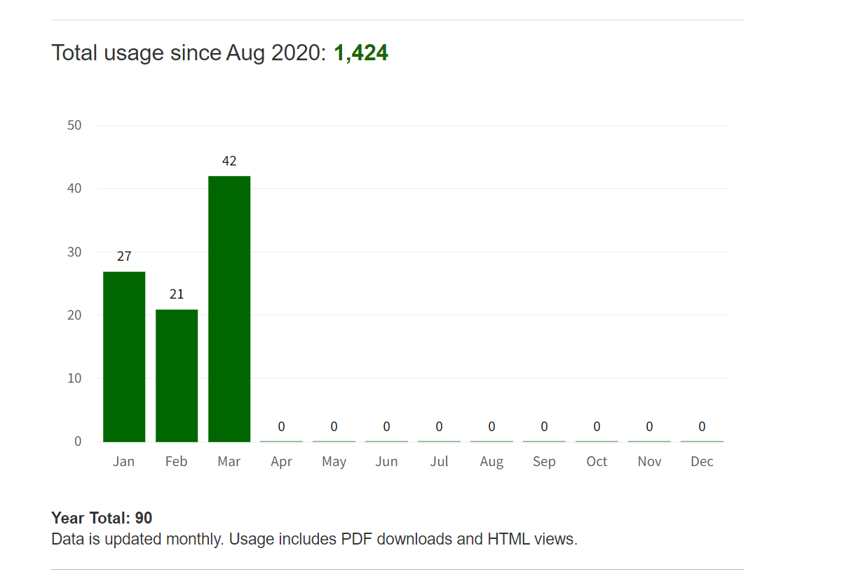
Performance metrics and Graphs

Slide 21
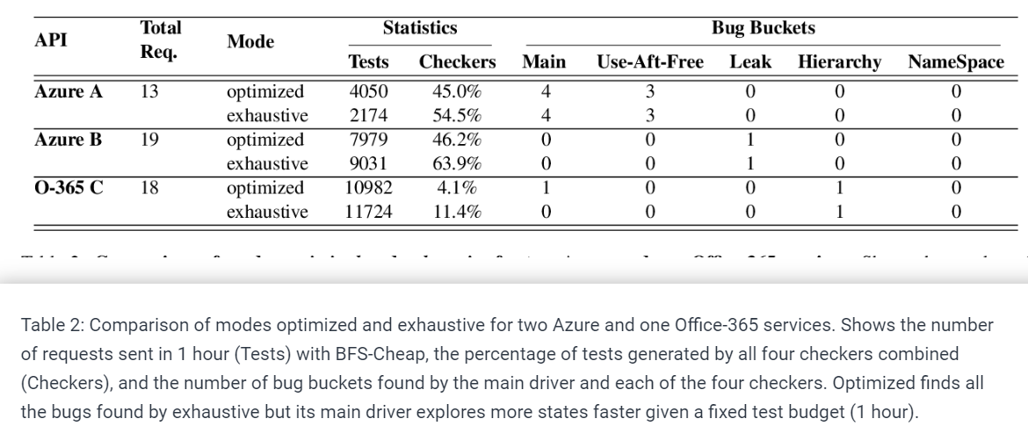
Results

Slide 22
Conclusion and future scope
Introduction of Four Security Rules: The paper introduces four security rules aimed at capturing desirable properties of REST APIs and services, highlighting their importance in ensuring secure interactions between clients and servers.
Extension of Stateful REST API Fuzzer: The paper discusses the extension of a stateful REST API fuzzer with active property checkers, enabling automatic testing and detection of violations of the aforementioned security rules.
Fuzzing of Production Azure and Office-365 Cloud Services: The researchers applied their fuzzing techniques to nearly a dozen production Azure and Office-365 cloud services, successfully uncovering new bugs in each service, with a significant proportion categorized as "500 Internal Server Errors" and rule violations detected by the new security checkers.
High Bug Fix Rate: The bugs identified through the fuzzing process were reported to the respective service owners, who took them seriously. The paper notes a nearly 100% bug fix rate, emphasizing the importance of addressing these vulnerabilities to mitigate potential security risks.
Implications and Future Directions: The findings suggest that violations of the introduced security rules pose potential security vulnerabilities, warranting proactive bug fixing to prevent potential security incidents. Additionally, the paper highlights the need for further research in fuzzing more services and checking additional properties to uncover different types of bugs and security vulnerabilities in the ever-expanding landscape of REST APIs for cloud and web services.

Slide 23
QUERIES? THANK YOU

